Slide 1

2021
Machine Learning
TYPE2HEART
Mohammad Zarak Shah Ji
Jahanzaib Malik
Machine Learning Project
Next

Slide 2


2021
Project Content
Part 1: Highlights.
Part 2: Introduction.
Part 3: Background
Part 4: Data and Model
Part 5: Experiments and Analysis of Results
Part 6: Conclusion
Machine Learning Project Presentation 2021

Slide 3
Highlights
The research project intended to focus on how to predict if a person dies because of some disease in some time t.
The focus was also on how much a certain disease (feature) has an impact on the prediction .
The reason behind doing this project was that, father of one of the team members suffered from related issue recently.
Eventually, the study helped in learning new concepts of machine learning as well as medical field.

Slide 4

2025
Introduction
Heart failure is a potential complication of type-2 diabetes, leading to disability or death. Recently, scientists have found that a new class of medications may be helpful for preventing heart failure in patients with diabetes but identifying those with the highest risk can be challenging.
Therefore, we tried to develop a risk score that would classify whether the patient has highest risk of heart failure or not. The risk score predictor is going to be named as WDC-MATH which stands for {Weight [BMI], Diabetes, Creatinine, myocardial infarction (MI), Age, high blood pressure, HDL-C (High-density lipoprotein (HDL) cholesterol), all these parameters being the major reason behind a heart failure in a diabetic person.
Machine Learning Project Presentation 2021

Slide 5

2025
Introduction
Although several risk predictions models have become available in T2DM, none to our knowledge have been specific to heart failure HF risk. This machine learning–based approach has unique advantages over traditional risk prediction. Approaches adequately handling these issues may be especially important for complex phenotypes such as HF.
In this project, we analyzed a dataset of 299 patients with heart failure collected in 2015. We applied random survival forest (RSF) for the training purpose of our data and predicted a risk-score for survival of the patients comprising the dataset we have used, and then we ranked the features corresponding to the most important risk factors using Permutation-based Feature Importance.
Machine Learning Project Presentation 2021

Slide 6

2021
Background
Cardiovascular diseases kill approximately 17 million people globally every year, and they mainly exhibit as myocardial infarctions and heart failures. Heart failure (HF) occurs when the heart cannot pump enough blood to meet the needs of the body. Available electronic medical records of patients quantify symptoms, body features, and clinical laboratory test values, which can be used to perform biostatistics analysis aimed at highlighting patterns and correlations otherwise undetectable by medical doctors. Machine learning can predict patients’ survival from their data and can individuate the most important features among those included in their medical records.
Machine Learning Project Presentation 2021

Slide 7
Technical Background
To understand the implementation of this project the reader must be familiar with some concepts that are associated with this project, which include the ones in the problem itself and the concepts given in the solution provided. So, the problem is simple (but the solution is not), we have some of the patients who are suffering from a disease called diabetes and are at a risk of having a heart attack which is one of the comorbidities arising due to presence of diabetes. So, our goal is to find out at how much risk an individual is based on the numerous factors or what we call features, that are part of our data. We want to find out based on time how much a person is at a risk of getting a Heart Failure. We also want to find out what are the factors in the dataset that most affect the risk of getting a Heart Failure.
Machine Learning Project Presentation 2021

Slide 8
2025
We analyzed a dataset containing the medical records of 299 heart failure patients collected at the Faisalabad Institute of Cardiology and at the Allied Hospital in Faisalabad (Punjab, Pakistan), during April–December 2015. The patients consisted of 105 women and 194 men, and their ages range between 40 and 95 years old. All 299 patients had left ventricular systolic dysfunction and had previous heart failures that put them in classes III or IV of New York Heart Association (NYHA) classification of the stages of heart failure.
Data and Model
Machine Learning Project Presentation 2021

Slide 9
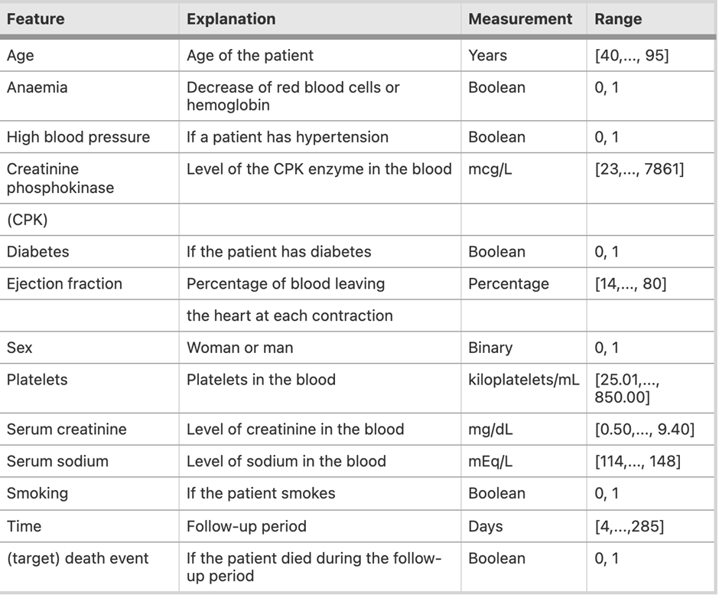
2025
Dataset
The dataset contains 13 features, which report clinical, body, and lifestyle information, that we briefly describe here. Some features are binary: anaemia, high blood pressure, diabetes, sex, and smoking. The hospital physician considered a patient having anaemia if haematocrit levels (the ratio of the volume of red blood cells to the total volume of blood) were lower than 36%. The death event feature, that we use as the target in our study, states if the patient died or survived before the end of the follow-up period, that was 130 days on average.
Machine Learning Project Presentation 2021

Slide 10
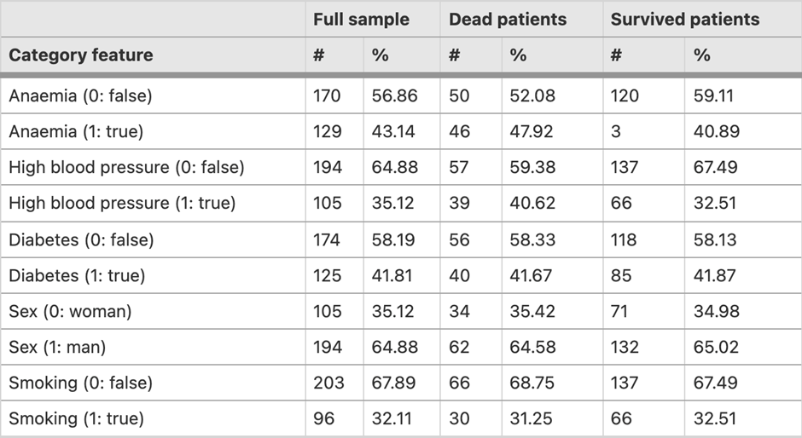
2025
Statistical quantitative description of the category features
#: number of patients
%: percentage of patients
Full sample: 299 individuals
Dead patients: 96 individuals
Survived patients: 203 individuals
Machine Learning Project Presentation 2021

Slide 11
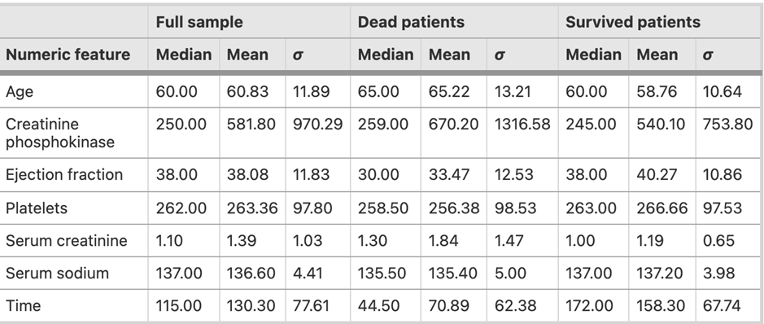
2025
Statistical quantitative description of the numeric features
Full sample: 299 individuals
Dead patients: 96 individuals
Survived patients: 203 individual
σ: standard deviation
Machine Learning Project Presentation 2021

Slide 12
2025
Regarding learning model, we focused on Random Survival Forests, because as it turns out to be the top performing model for our problem to be addressed
The Random Survival Forests is based on Survival Analysis. The objective in survival analysis — also referred to as reliability analysis in engineering — is to establish a connection between covariates and the time of an event. Survival analysis is a type of regression problem (one wants to predict a continuous value), but with a twist. It differs from traditional regression by the fact that parts of the training data can only be partially observed – they are censored.(any data for which we do not know the exact event time)
Learning Models
Machine Learning Project Presentation 2021

Slide 13
2025
Measuring the Performance
Once we fitted our survival model, we wanted to assess how well our model can predict survival. Our test data was usually subject to censoring too, therefore metrics like root mean squared error or correlation were unsuitable. Instead, we used generalization of the area under the receiver operating characteristic (ROC) curve called Harrell’s concordance index or c-index. (metric to evaluate the predictions made by an algorithm.)
Machine Learning Project Presentation 2021

Slide 14
Feature Importance
One of the most basic questions we asked of a model is: What features had the biggest impact on predictions?
Therefore, after extensive researching we found out multiple ways to measure feature importance. Some approaches answer subtly different versions of the question above. Other approaches have documented shortcomings. We kept our focus on permutation importance.
Permutation importance uses models differently than anything you've seen so far, and many people find it confusing at first. Permutation feature importance measures the increase in the prediction error of the model after we permuted the feature’s values, which breaks the relationship between the feature and the true outcome. The concept is straightforward: We measure the importance of a feature by calculating the increase in the model’s prediction error after permuting the feature. A feature is “important” if shuffling its values increases the model error, because in this case the model relied on the feature for the prediction. A feature is “unimportant” if shuffling its values leaves the model error unchanged, because in this case the model ignored the feature for the prediction. The permutation feature importance measurement was introduced by Breiman (2001) for random forests.
Machine Learning Project Presentation 2021

Slide 15
2025
Experiments and
Analysis of Results
We implemented the idea using Random Survival Forests introduced in scikit-survival 0.11.
Machine Learning Project Presentation 2021

Slide 16
Implementation:
First, we needed to load the data and transform it into numeric values. Next, we acquired all the features for the model and generated a feature list and transformed feature variable. After that, we acquired and preprocessed the Event and 'time to event' variable for the model. To be fully compatible with scikit-learn, Status and Survival-in-days needed to be stored as a structured array with the first field indicating whether the actual survival time was observed or if was censored, and the second field denoting the observed survival time, which corresponds to the time of death (if Status == 'dead', 𝛿=1) or the last time that person was contacted (if Status == 'alive', 𝛿=0). where 𝛿= an event indicator 𝛿∈ {0;1}.
Next, the data splitting was done so that we could determine how well our model generalizes. According to the features and outcome variable the split was decided to be 90% for training and 10% for testing so that the test data contains the patients equally comprising of having a right censored outcome and un-censored outcome.
Machine Learning Project Presentation 2021

Slide 17
Implementation...
Using the training data, then we fit a Random Survival Forest comprising 240 trees. Our test data was subject to censoring too, therefore metrics like root mean squared error or correlation were unsuitable. Instead, we used generalization of the area under the receiver operating characteristic (ROC) curve called Harrell’s concordance index or c-index.
The interpretation is identical to the traditional area under the ROC curve metric for binary classification: - a value of 0.5 denotes a random model, - a value of 1.0 denotes a perfect model, - a value of 0.0 denotes a perfectly wrong model. The concordance index of our model turned out to be 0.70, which indicates that the model clearly performs better than random and is a good a value as per the results reported in the Random Survival Forests paper.
Machine Learning Project Presentation 2021

Slide 18
2025
Predicting WDC-MATH risk score
We used the random survival forest predict function to get the risk scores for our patients.
Machine Learning Project Presentation 2021

Slide 19
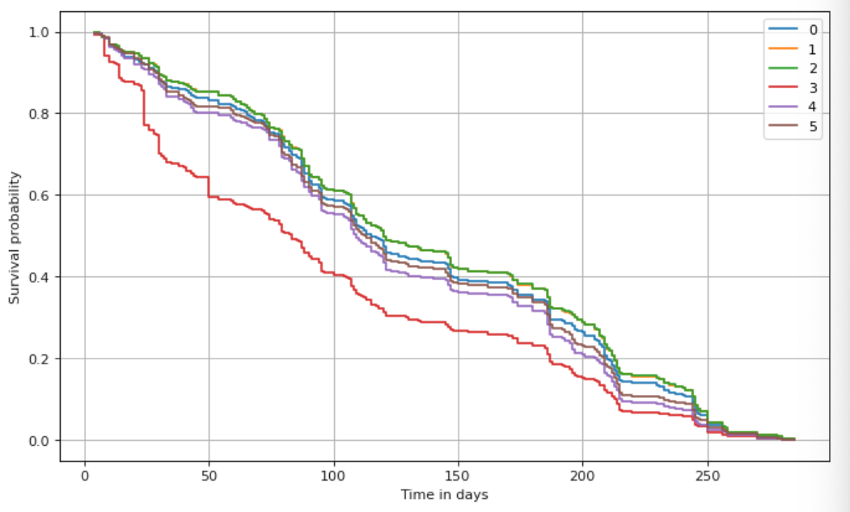
2025
Predicting
We selected a couple of patients from the test data according to the binary number of diabetes and high blood pressure. The predicted risk scores indicated that risk for a Heart failure (HF) in the patients with risk score greater than 140 is more as compared to the patients with score less than that if we are taking into consideration the dataset we have used. We then used predict survival function to have more detailed visual insight. It showed that the biggest difference occurs roughly within the first 125 days. The patient labelled 3 in the predicted set we took is being an anomaly because of the values of age, diabetes and high blood pressure and is likely on greater risk as compared to other patients in the dataset.
Machine Learning Project Presentation 2021

Slide 20
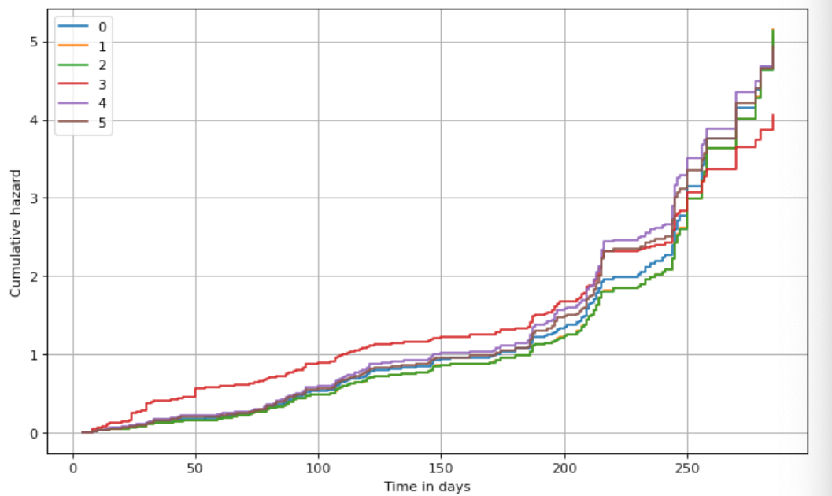
2025
Prediction values plotted using cumulative hazard function
Alternatively, we also plotted the predicted cumulative hazard function to measure the total amount of risk that has been accumulated up to time t.
Machine Learning Project Presentation 2021

Slide 21

Permutation-based Feature Importance
1
High blood pressure
2
Serum creatinine

Slide 22

0.1193
To check the biggest impact on predictions by the features we have used, we analyzed Permutation-based Feature Importance. The Feature permutation importance is a model-agnostic global explanation method that provides insights into a machine learning model’s behavior. It estimates and ranks feature importance based on the impact each feature has on the trained machine learning model’s predictions.
When interpreting Permutation importances the values towards the top are the most important features in the table generated by it, and those towards the bottom matter least.
The result showed us that the high blood pressure is by far the most important feature. If its relationship to survival time is removed (by random shuffling), the concordance index on the test data drops on average by 0.1193 points.

Slide 23
Machine Learning Project Presentation 2021
Analyzing the results:

Slide 24
Analyzing results:
The statistical analysis of our project identified, EF, creatinine, sodium, anaemia and BP as the significant variables affecting the likelihood of mortality among heart failure patients .
The experimentation that we did for selecting different values for number of trees to be used showed us that having 1000 trees resulted in less concordance index as compared to selecting 240 trees.
Additionally, when we considered the predict survival function to visualize the values, it showed that the biggest difference occurs roughly within the first 125 days.
With some deep analyzing of the results, we came to find out that the patient with highest risk score of 173.9 in the dataset didn’t have diabetes and the main reasons behind the high-risk score could have been his age of 80 and the presence of high blood pressure.
Machine Learning Project Presentation 2021

Slide 25
Analyzing results:
The findings that seem surprising are non-significance of smoking and diabetes. However, similar results concerning diabetes and smoking have been reported in other related studies as well. The reason behind may be smoking and diabetes are basically causes of heart problem at initial stages. We were only concerned with patients of New York Heart Association (NYHA) class III and IV which are advanced stages of heart failure. Up to these stages, these factors (diabetes and smoking) may probably be controlled by medications and hence these factors do not have significant effect on deaths due to heart failure in class III and IV.
Machine Learning Project Presentation 2021

Slide 26
2025
Conclusion
It can be concluded that growing age, renal dysfunction (having serum creatinine greater than its normal level 1.5), high BP, presence of anaemia and lower values of ejection fraction (EF) are the key factors contributing towards increased risk of mortality among heart failure patients
Increased level of serum sodium can reduce the odds of death
No significant differences were found due to smoking status, diabetes and gender of patients.
As a limitation of our present study, we have to report the small size of the dataset (299 patients): a larger dataset would have permitted us to obtain more reliable results
Regarding future developments, we plan to apply machine learning to alternative datasets of cardiovascular heart diseases and other illnesses
Machine Learning Project Presentation 2021

Slide 27
Thank you.

